Slide 1
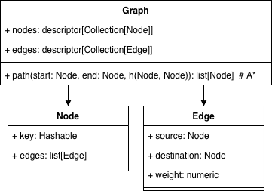
A* Pathfinding Algorithm
This project aims to create a flexible implementation of the A* pathfinding algorithm based upon an improved version of the Graph data structure from Lab 13.
A* is a common pathfinding algorithm which is used to determine the most optimal path between two graph vertices while minimizing the time spent visiting unnecessary nodes. This is achieved by using a heuristic function to estimate the remaining cost to reach the goal after traversing to a previously unexplored node. The algorithm greedily selects the next node with the lowest current + estimated cost.
The ultimate goal of the project is to create an API for A* in such a way that both the underlying Graph datatype and the heuristic function can be easily modified or entirely replaced to fit the needs of a specific implementation.
This implementation of A* will utilize a priority queue to track the estimated total cost of known but unvisited nodes to visit next. A hash table will also be used to track the known cost of previously-visited nodes, and the current shortest path to those nodes.
The user interface requirement will utilize a modified version of the UI from Lab 13 as a proof-of-concept implementation. The UI will:
Allow users to view a printed image of the graph (utilizing a library such as matplotlib)
Allow adding new nodes/edges
Allow users to request the shortest path between two nodes
Visualize the stepwise execution of A* and its result on the graph
Test Plan:
Create a test graph with ~20 nodes
Run Dijkstra’s algorithm on a node to determine the optimal path length to each other node
Run A* from that node to all other nodes, ensure path length matches Dijkstra.
Timeline:
5/5: Graph data structure complete (part of Lab 13)
5/7: A* implemented
5/10: Modifications to Lab 13 UI underway
5/12: Modifications to UI complete, testing underway
5/14: Presentation
5/19: Code Turned In
Impact & Limitations:
With no additional heuristic beyond the weight of edges between nodes, A* is effectively a version of Dijkstra’s algorithm which terminates once the target node is found. However, the primary power of A* is the ability to customize the heuristic function based on the properties of the graph.
For instance, if the graph represents a road network where each node is an intersection, the geographic linear distance between each node and the target can be incorporated into the heuristic function, “guiding” A* to prefer steps which lower that distance over those that increase it.
Notes:
Project Title – concise and descriptive.
Objective / Problem Statement – one sentence summarizing the goal or real-world problem addressed.
High-Level Description – brief overview of what the application will do and why it matters.
Key Data-Structure Concepts – bullets naming the course topics (graphs, stacks, heaps, etc.) you’ll leverage. You may omit details of the future greedy / dynamic algorithm for now.
Architecture Diagram – UML class diagram or activity diagram showing main classes/functions, data flow, and user interaction.
Core Functionality – bullets outlining major features the program will provide.
Testing & Evaluation Plan – how you will verify correctness and measure success.
Project Timeline – milestone dates up to finals week (design, coding, testing, polish).
Anticipated Impact & Blind Spots – one-to-two sentences on benefits and limitations.

